Slide 1
Using MIDI with CircuitPython
Liz Clark
Creative Engineer, Adafruit Industries

Slide 2
What is MIDI?
Acronym: Music Instrument Digital Interface
7-bit communication protocol
  Dates back to the 1980’s
Dependable, predictable, reliable

Slide 3
How MIDI is Transmitted
Bidirectional
  MIDI in: receiving MIDI messages as an input
  MIDI out: sending MIDI messages as an output
MIDI Channels
  Messages are sent via channels, 1-16
  Allow devices to know what and who to listen to

Slide 4
Connection Types
DIN-5
TRS-A/TRS-B
USB
The original MIDI connector
MIDI via an 1/8” audio jack
Small form factor, but not always standardized
Plug and play
Bidirectional
You’ll be using this today

Slide 5
BLE MIDI
Wireless MIDI transmission
Support is available in CircuitPython
  Can be used on the Circuit Playground Bluefruit

Slide 6
MIDI Messages

Slide 7
Noteon and noteoff
How notes are played
  i.e. when you play a piano keyboard
Notes in MIDI are numbered 1-127
  Ex: C4/Middle C is 60
  MIDI note numbers and center frequencies
Velocity: strength, force, loudness
Notes:
Great example of the computer does exactly what you tell it to do. If a noteoff message is never sent that matches the note number, then the noteon keeps playing

Slide 8
ControlChange
Utility messages, functionality varies
  Usually sent by a knob or a slider
Common examples: sustain, modulation, breath control
  CC Message table
CC message contains the message number and the value (0-127)

Slide 9
PitchBend
Special MIDI message, but very common
Unique range 0-16383, with 8192 as the midrange/no bend

Slide 10
Let’s Build!

Slide 11
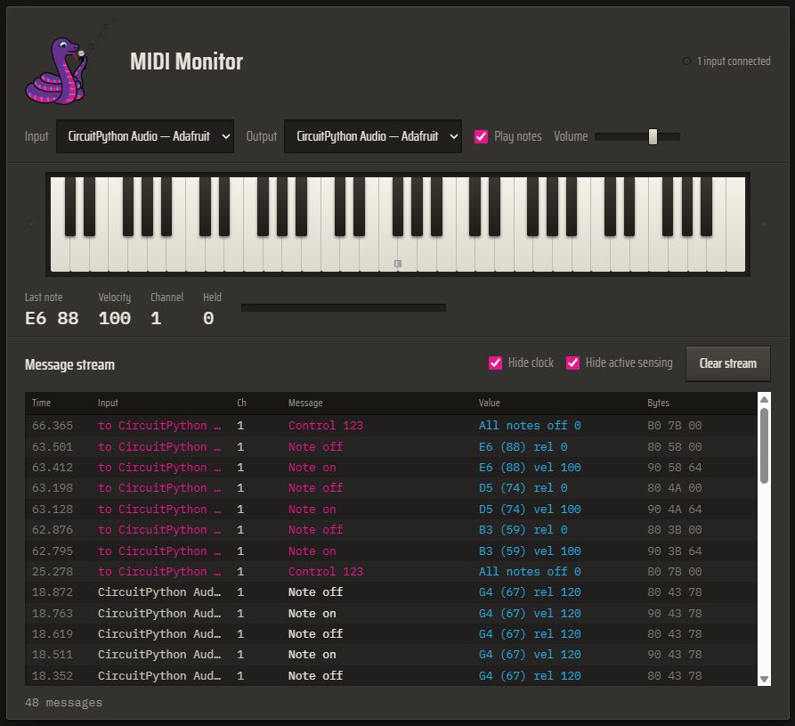
MIDI with CircuitPython Lab
Using the Circuit Playground Bluefruit
Interface with the MIDI Monitor for debugging and testing
  Runs in your browser (Chrome, Firefox, Edge) and OS agnostic

Slide 12
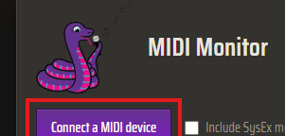
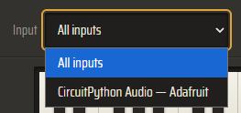
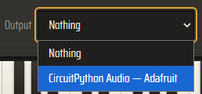
How to Connect
Click Connect a MIDI device
Select input
Select output

Slide 13
1. NeoPixel MIDI Listener
Create a MIDI input device
The code should listen for NoteOn and NoteOff messages
The message type and value should print to the Serial Console
When a message is received, the NeoPixels should light up
  Each message should have a color associated with it
For testing, connect to the MIDI Monitor as an output and click on the keyboard notes

Slide 14
2. Capacitive touch MIDI Keyboard
Use the seven capacitive touch pads to send NoteOn and NoteOff messages
  NoteOn should send when touched, NoteOff should send when released
Start on C4
For testing, connect to the MIDI Monitor as an input and watch the message stream
  You will also be able to hear the notes if Play Notes is checked off
Bonus: light up the NeoPixels a different color for each NoteOn message, turn off for NoteOff

Slide 15
3. Change Octaves
Build on the cap touch keyboard code:
Use the D4 and D5 buttons to go up or down an octave for the notes that are sent
For testing, connect to the MIDI Monitor as an input and watch the message stream

Slide 16
4. Send CC Messages with the Accelerometer
Send Modulation CC values to the MIDI Monitor
Use simpleio map_range to map the accelerometer values to the CC range (0-127)
  Hint: it may be helpful to run accelerometer code first to get a better idea of the value ranges before adding MIDI
For testing, connect to the MIDI Monitor as an input and watch the message stream

Slide 17
5. Send CC Messages with the Light Sensor
Send Modulation CC values to the MIDI Monitor
Use simpleio map_range to map the light sensor values to the CC range (0-127)
  Hint: it may be helpful to run light sensor code first to get a better idea of the value ranges before adding MIDI
For testing, connect to the MIDI Monitor as an input and watch the message stream

Slide 18
6. BLE MIDI
Choose your favorite demo so far and change the MIDI init at the top of the code from USB to BLE

Slide 19
7. MIDI Sequencer
Build an 8-step sequencer on the Circuit Playground Bluefruit
  Send a NoteOn followed by a NoteOff message for a randomly selected note automatically in the loop
  A single NeoPixel should light up with a NoteOn message, turn off with NoteOff
    The NeoPixels should wrap, start with pixel 0 and go up to pixel 9, wrap back to pixel 0
  The D7 slide switch should control whether the sequencer is running
Bonus: use the D4 and D5 buttons to slow down or speed up the sequencer

